Slide 1

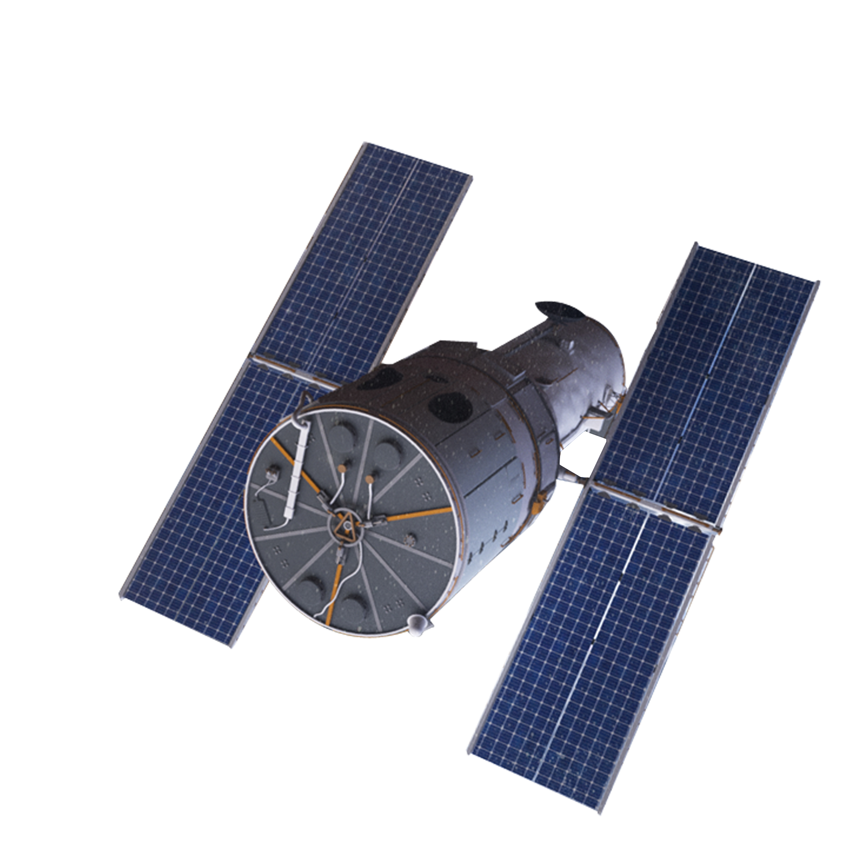
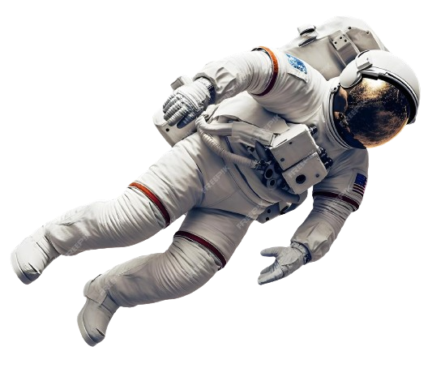

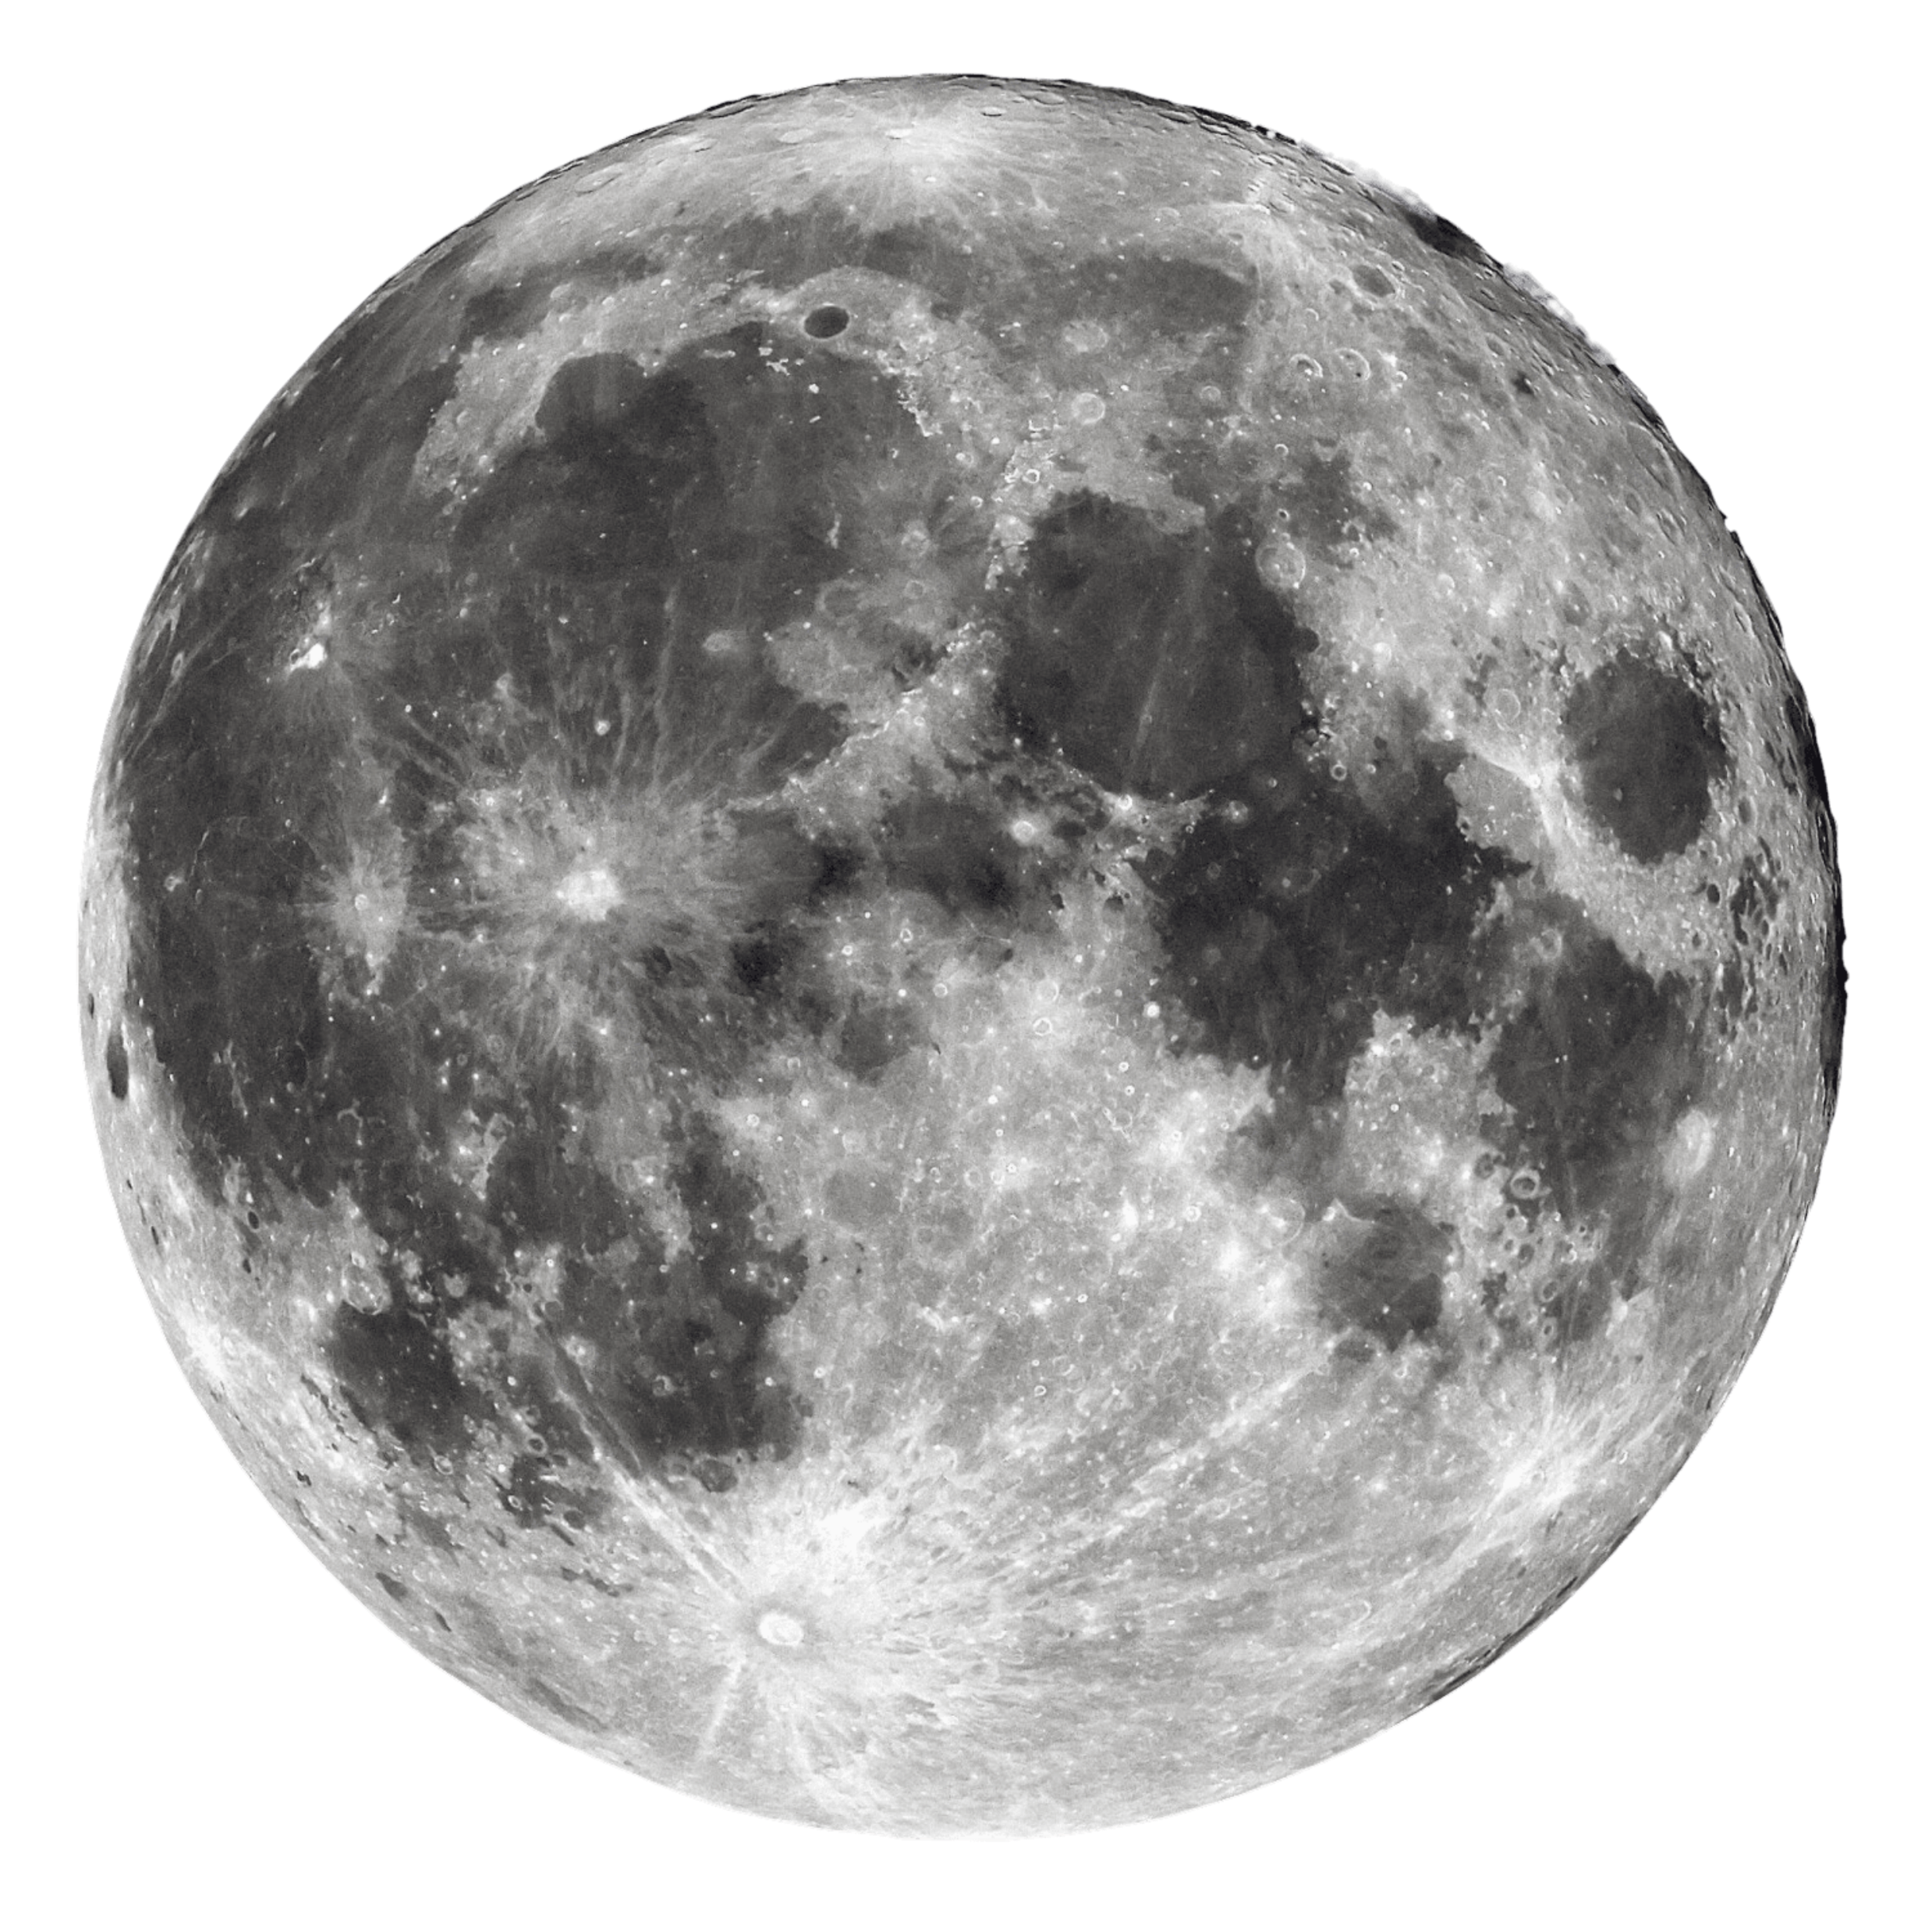
EARTH

Slide 2
SPACE

Slide 3
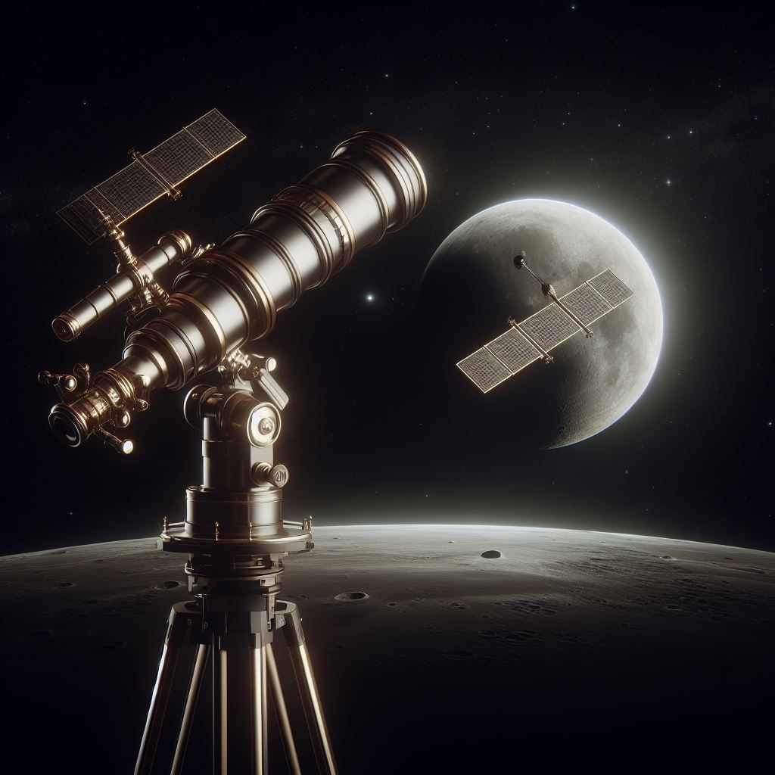

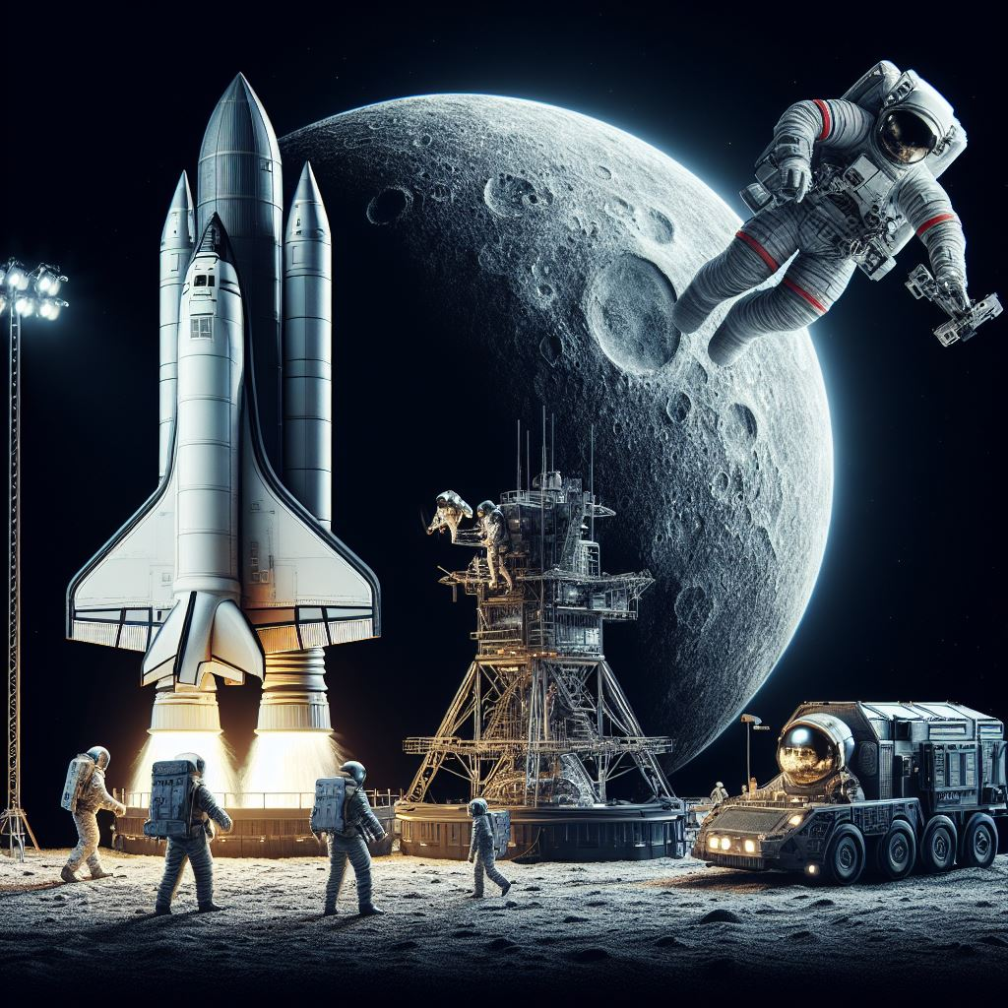
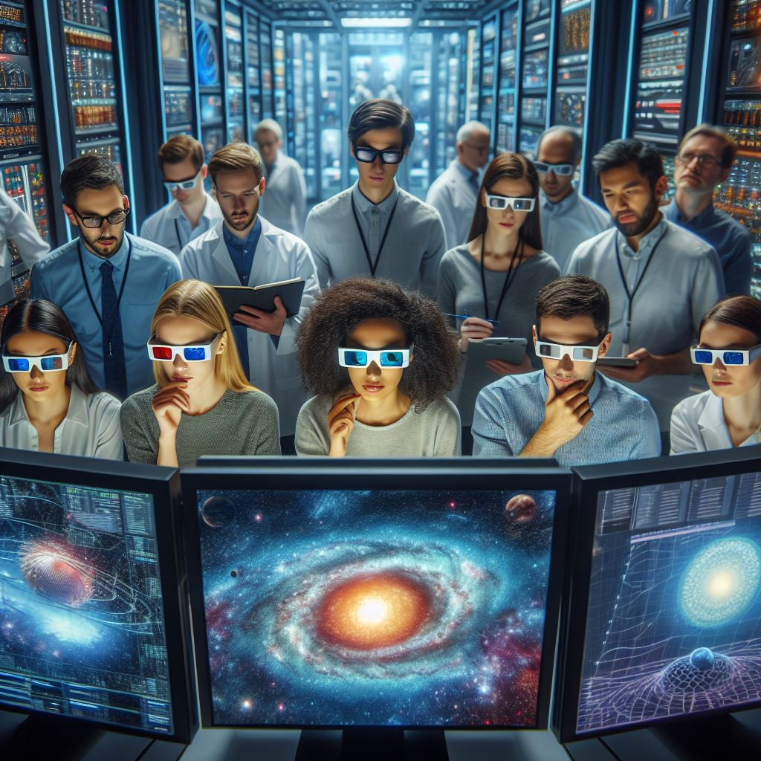

MAIN ENTITIES
The Space Operations Mission Directorate is a key division of
NASA, responsible for maintaining continuous human presence in
space. This contributes to advancements in scientific knowledge
and technology development on Earth. The directorate oversees
various programs that are central to NASA’s human space
exploration efforts, enabling missions such as Artemis,
commercial space initiatives, and scientific research. It provides
essential services like communication, launch services, and
research capabilities to support these missions. In summary,
Space Operations Mission Directorate plays a critical role in
facilitating space exploration and enhancing our understanding
of the universe.

Slide 4
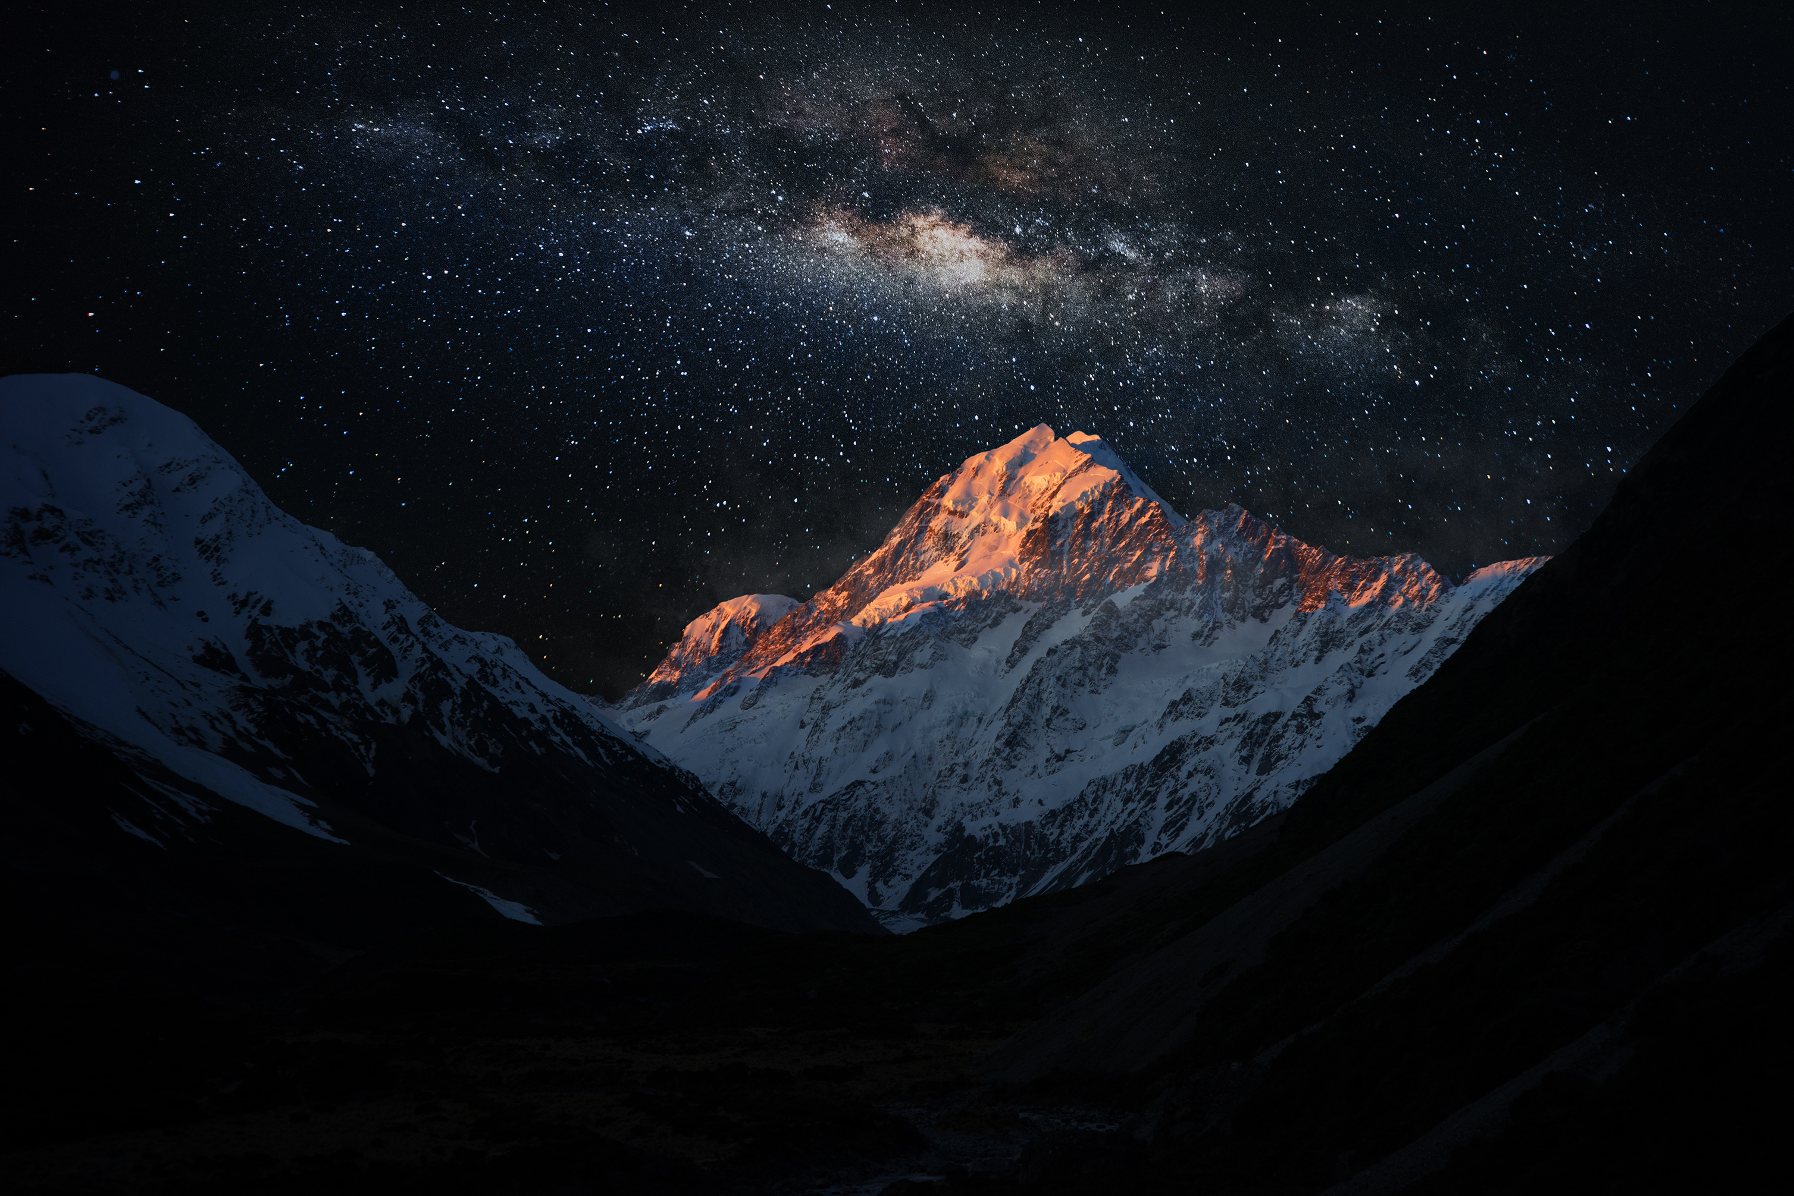
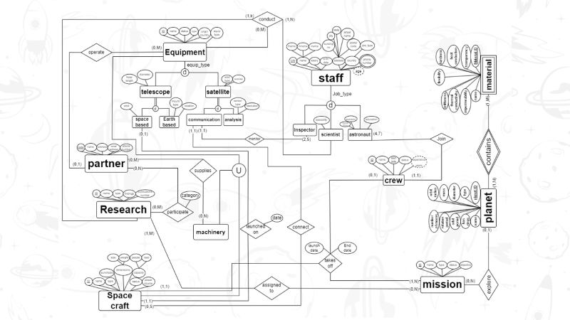
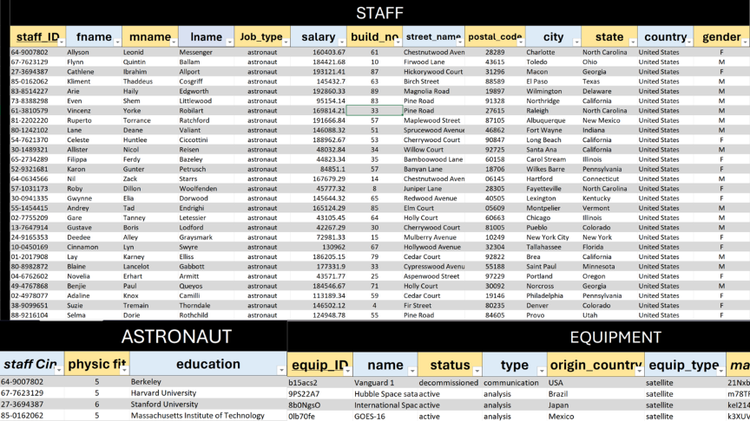
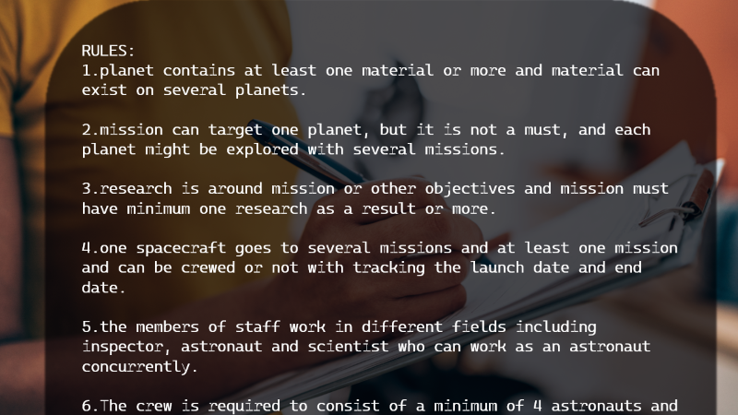
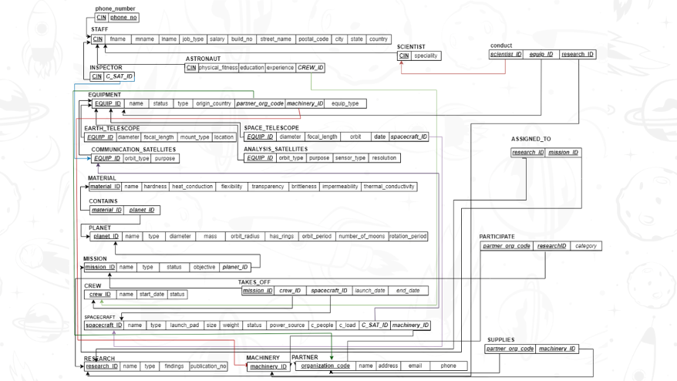
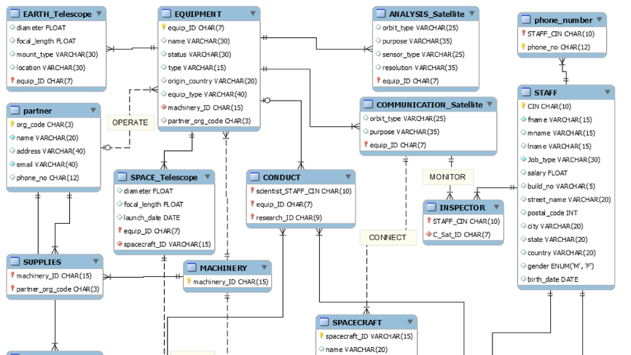
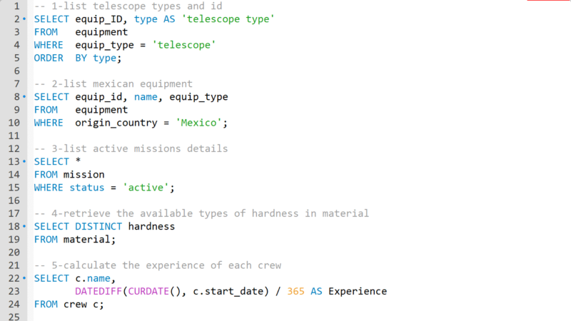
MAIN ENTITIES
SQL_MODEL

Slide 5
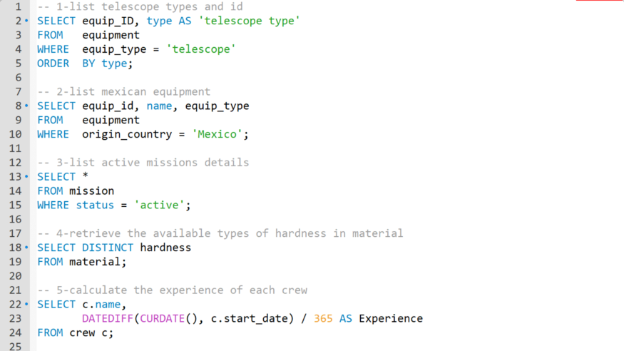

RULES
RELATIONAL
Sample Of Inserts
EER
SQL_MODEL
SQL_Queries

Slide 6

STAFF
(astronaut,scientist,inspector………etc)
citizen identification number.
fname, mname ,lname.
{home address}: building no., street name, postal code, city, state, country.
phone number {up to 3 numbers},
Salary.
Birth date(age).
:astronaut: :scientist:
Education. * specialty.
Experience.
physical fitness (up to 10).
*-experience is the total years of working of the astronaut even outside of the current job.

Slide 7
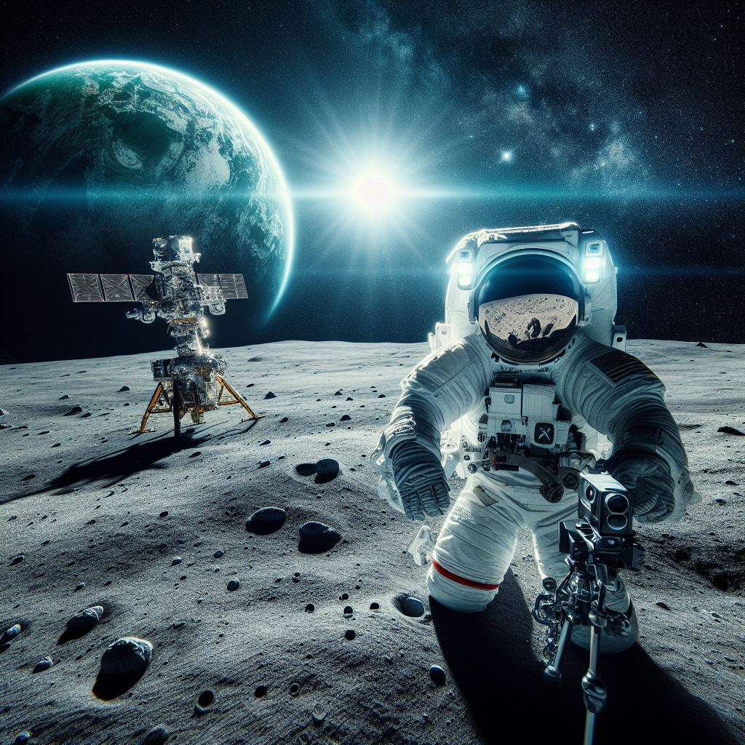
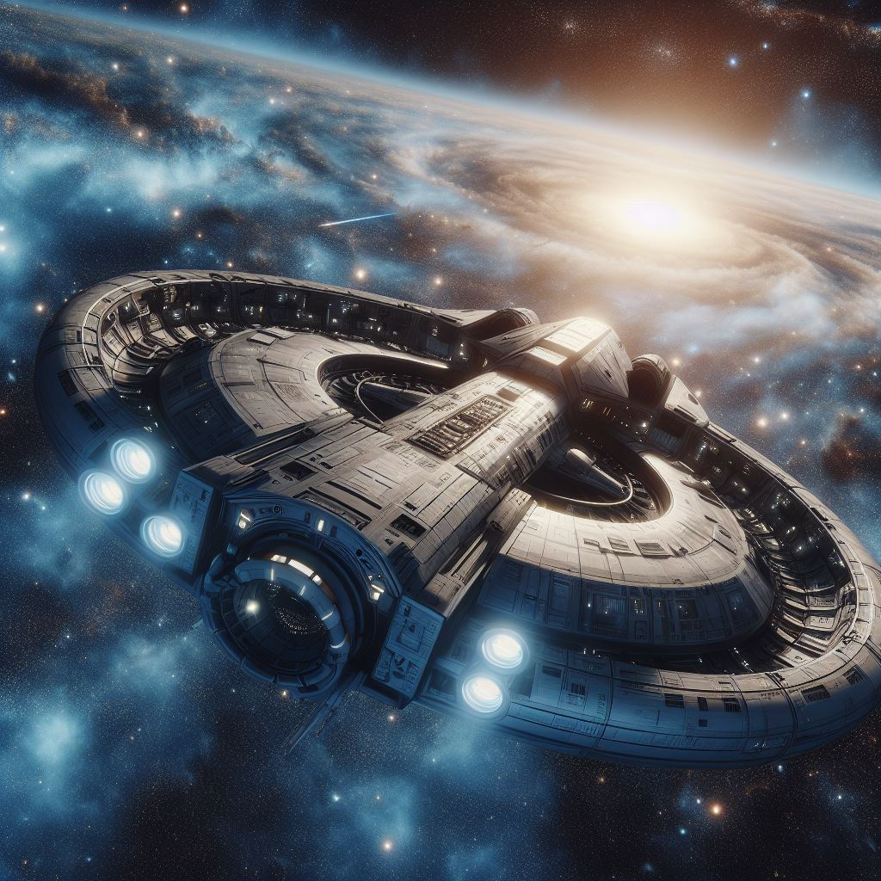
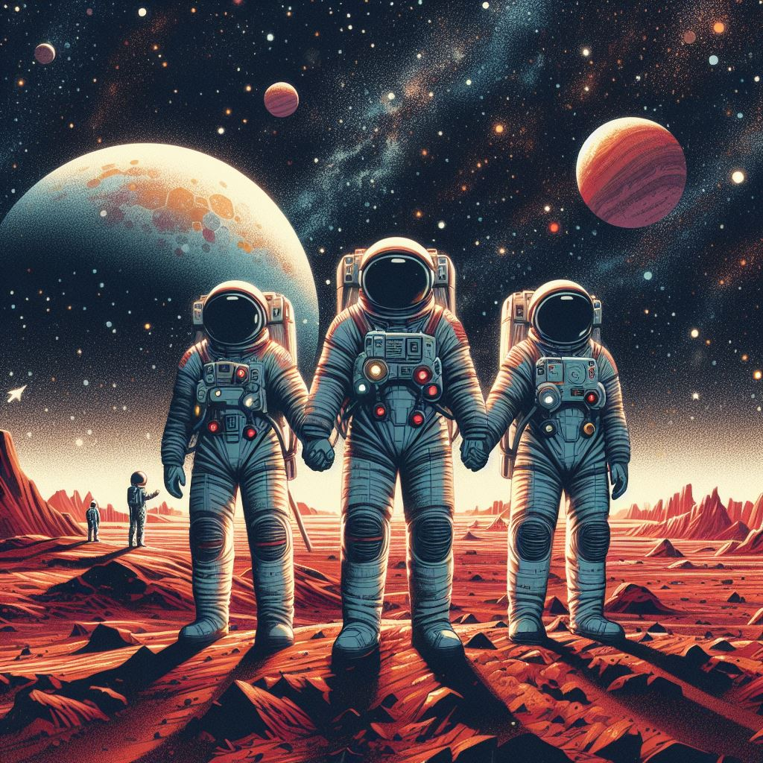
SPACECRAFT
spacecraftID,name,
type{rover,probe,crew,auto},
launchpad,
status{active,lost,retired}, Power Source(solar,nuclear),
dimensions{size and weight},
people capacity,
load capacity.
CREW
Crew ID,
name,
status,
start date.
MISSION
MissionID (primary key),
Mission Name,
Mission Type (e.g., Airborne Science, Analog Field Testing, Asteroid Deflection, Atmospheric Probe, Balloon, Crew, Commercial Resupply),
Status(active,future,past), and objective.

Slide 8

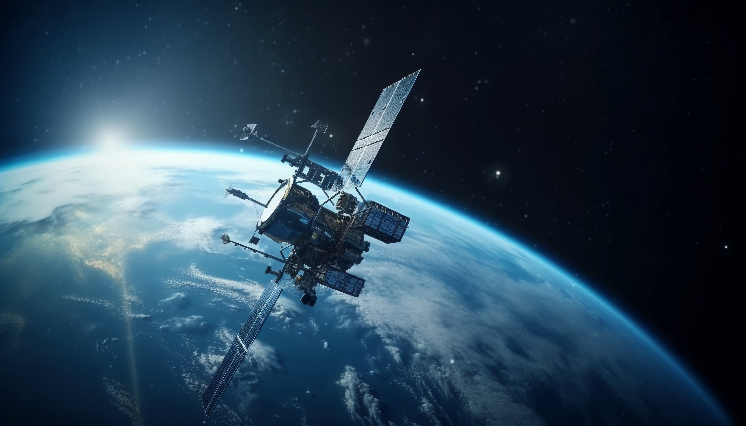
EQUIPMENT
:(satellites, telescopes…………etc.):
ID, name, Status:(e.g., active, decommissioned), type, origin country.
:Satellite:
(communication, analysis):
Orbit Type {(e.g., geostationary, polar, low Earth)}, Purpose:{(e.g., Earth observation, scientific research, GPS)}.
* analysis: sensor type and resolution.
:telescope:
focal length, diameter.
* space-based : * Earth-based:
- Orbit. - Mounttype,location.

Slide 9

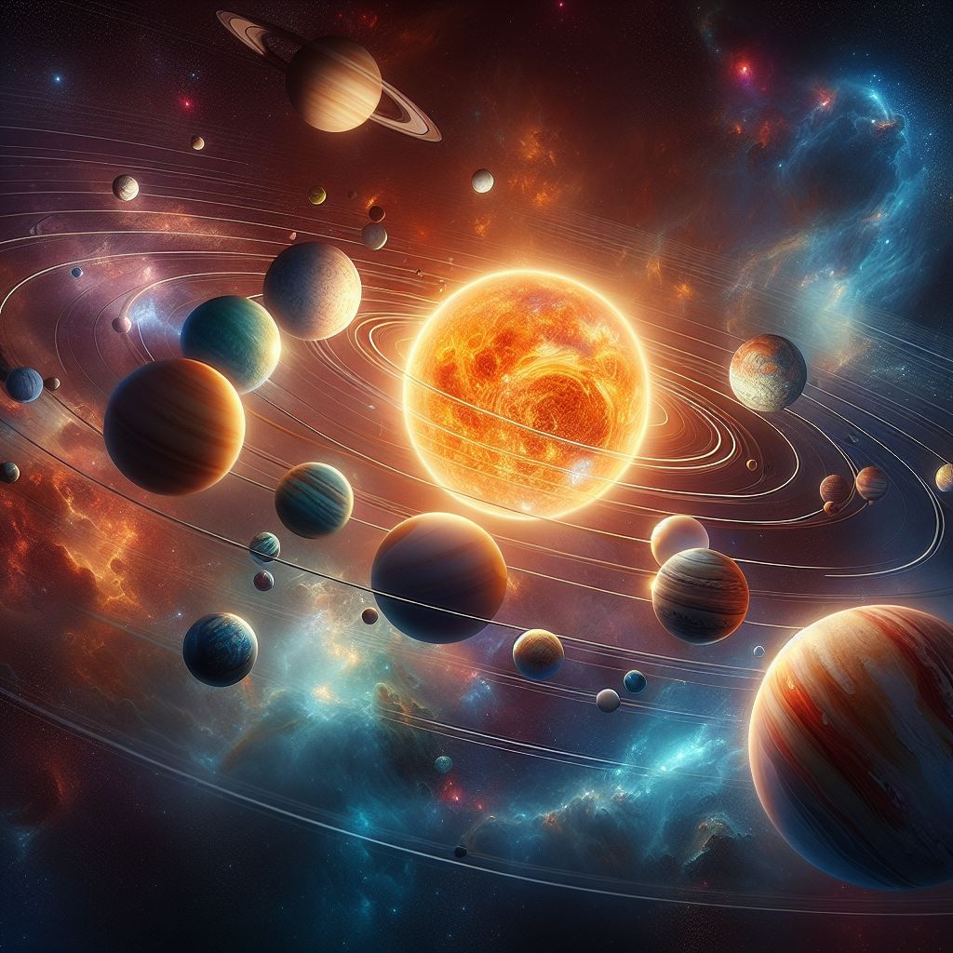
MATERIAL
MaterialID (primary key), Material Name,
Hardness,
Brittleness,
Flexibility,
Impermeability, Transparency,
Thermal Conductivity
And Heat Conduction.
PLANET
PlanetID (primary key), Planet Name,
Type(terrestrial or gas),
Diameter,
Mass,
Orbit Radius,
Orbit Period,
Rotation Period,
Number of Moons,
and Has Rings.

Slide 10
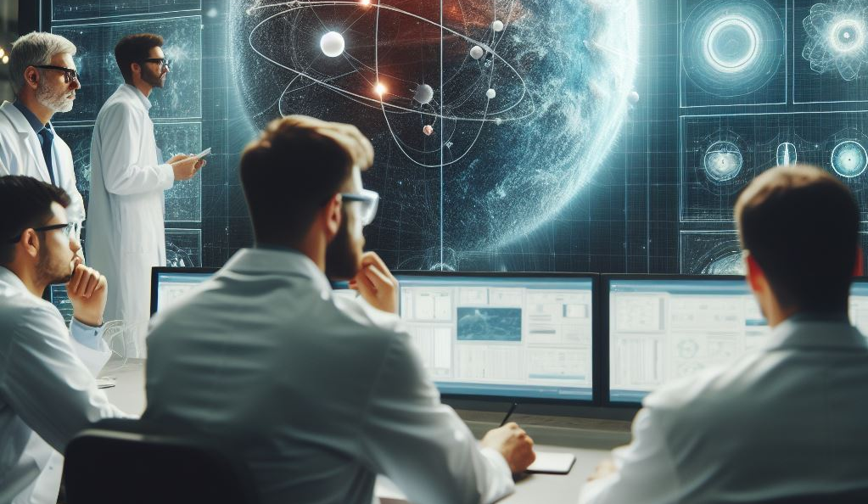
RESEARCH
research ID,name,
type{e.g., Aeronautics, Space Environmental Effects, Renewable Energy and Building Energy Efficiency, Material Response Properties},
findings,
publications no.
PARTNERS
organization code,
organization name,
address,
email address,
phone number.

Slide 11

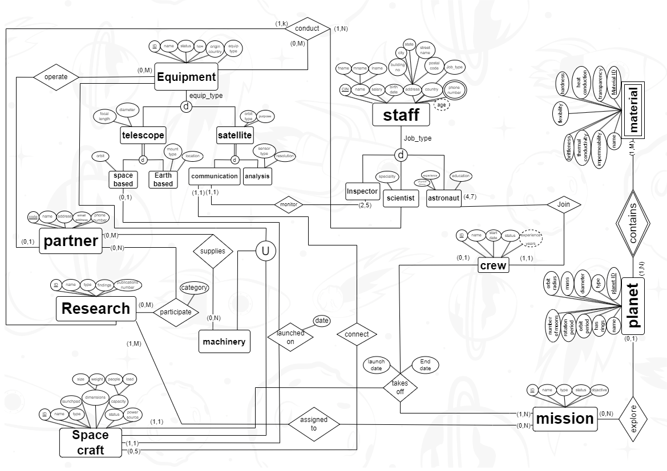


Slide 12
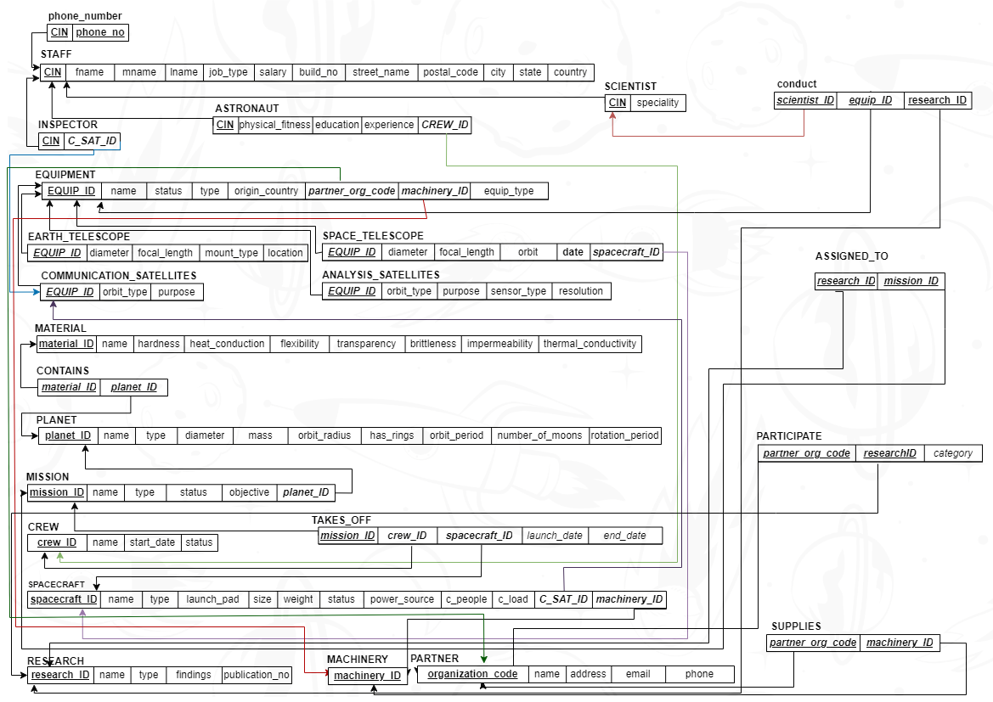

Slide 13
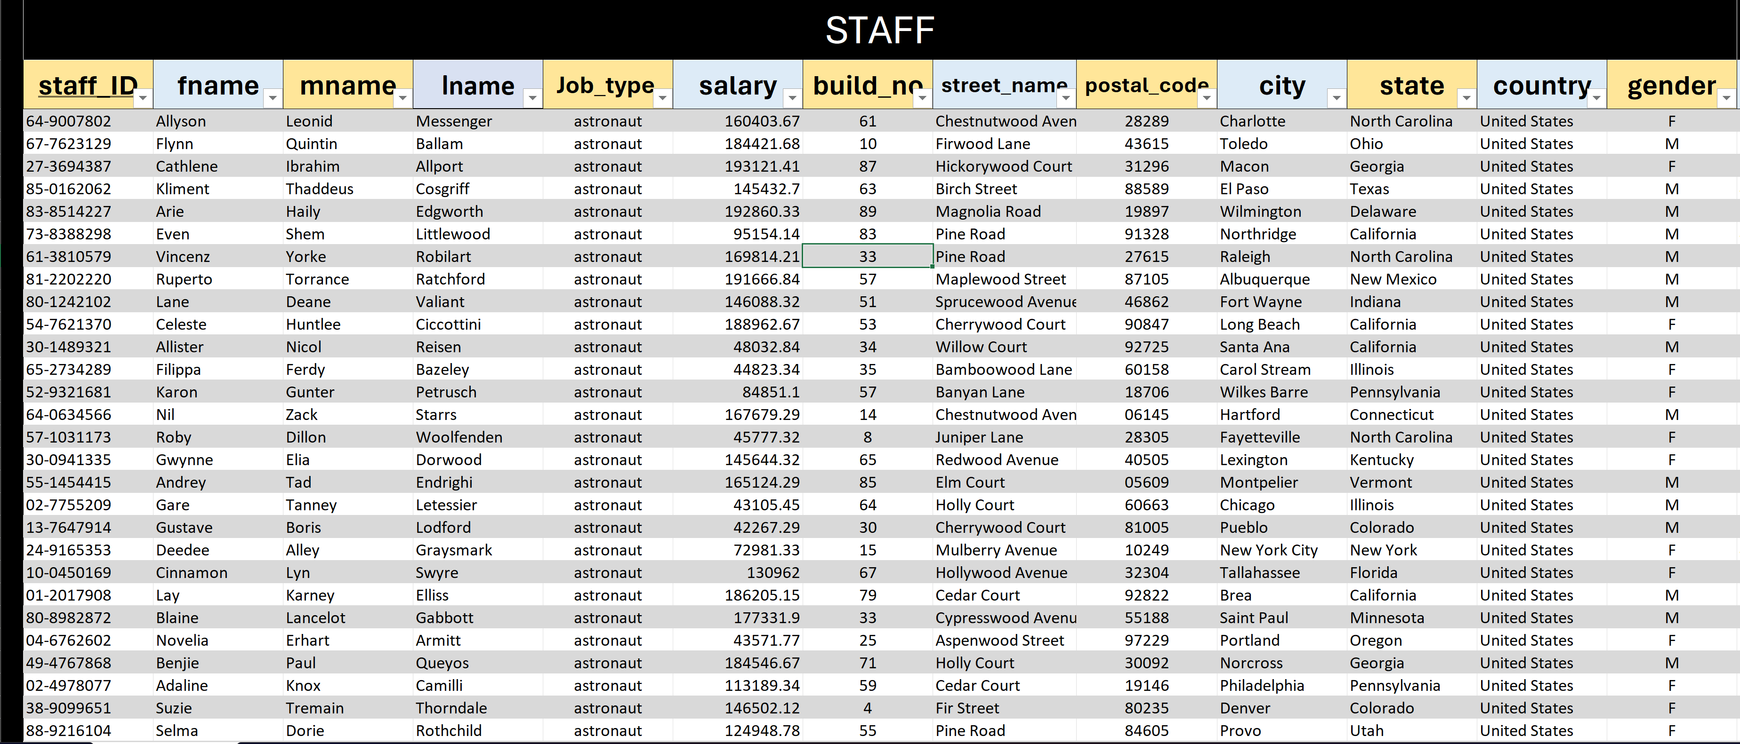
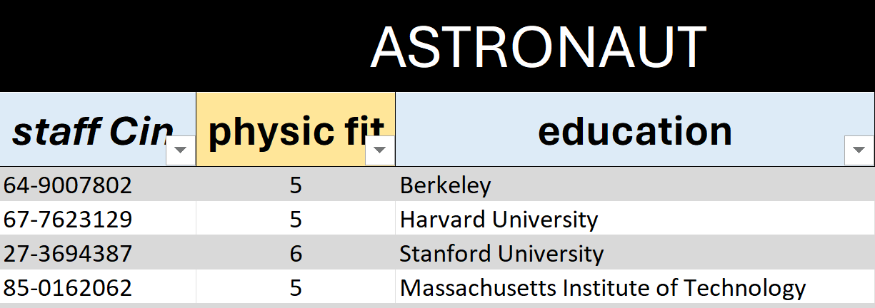
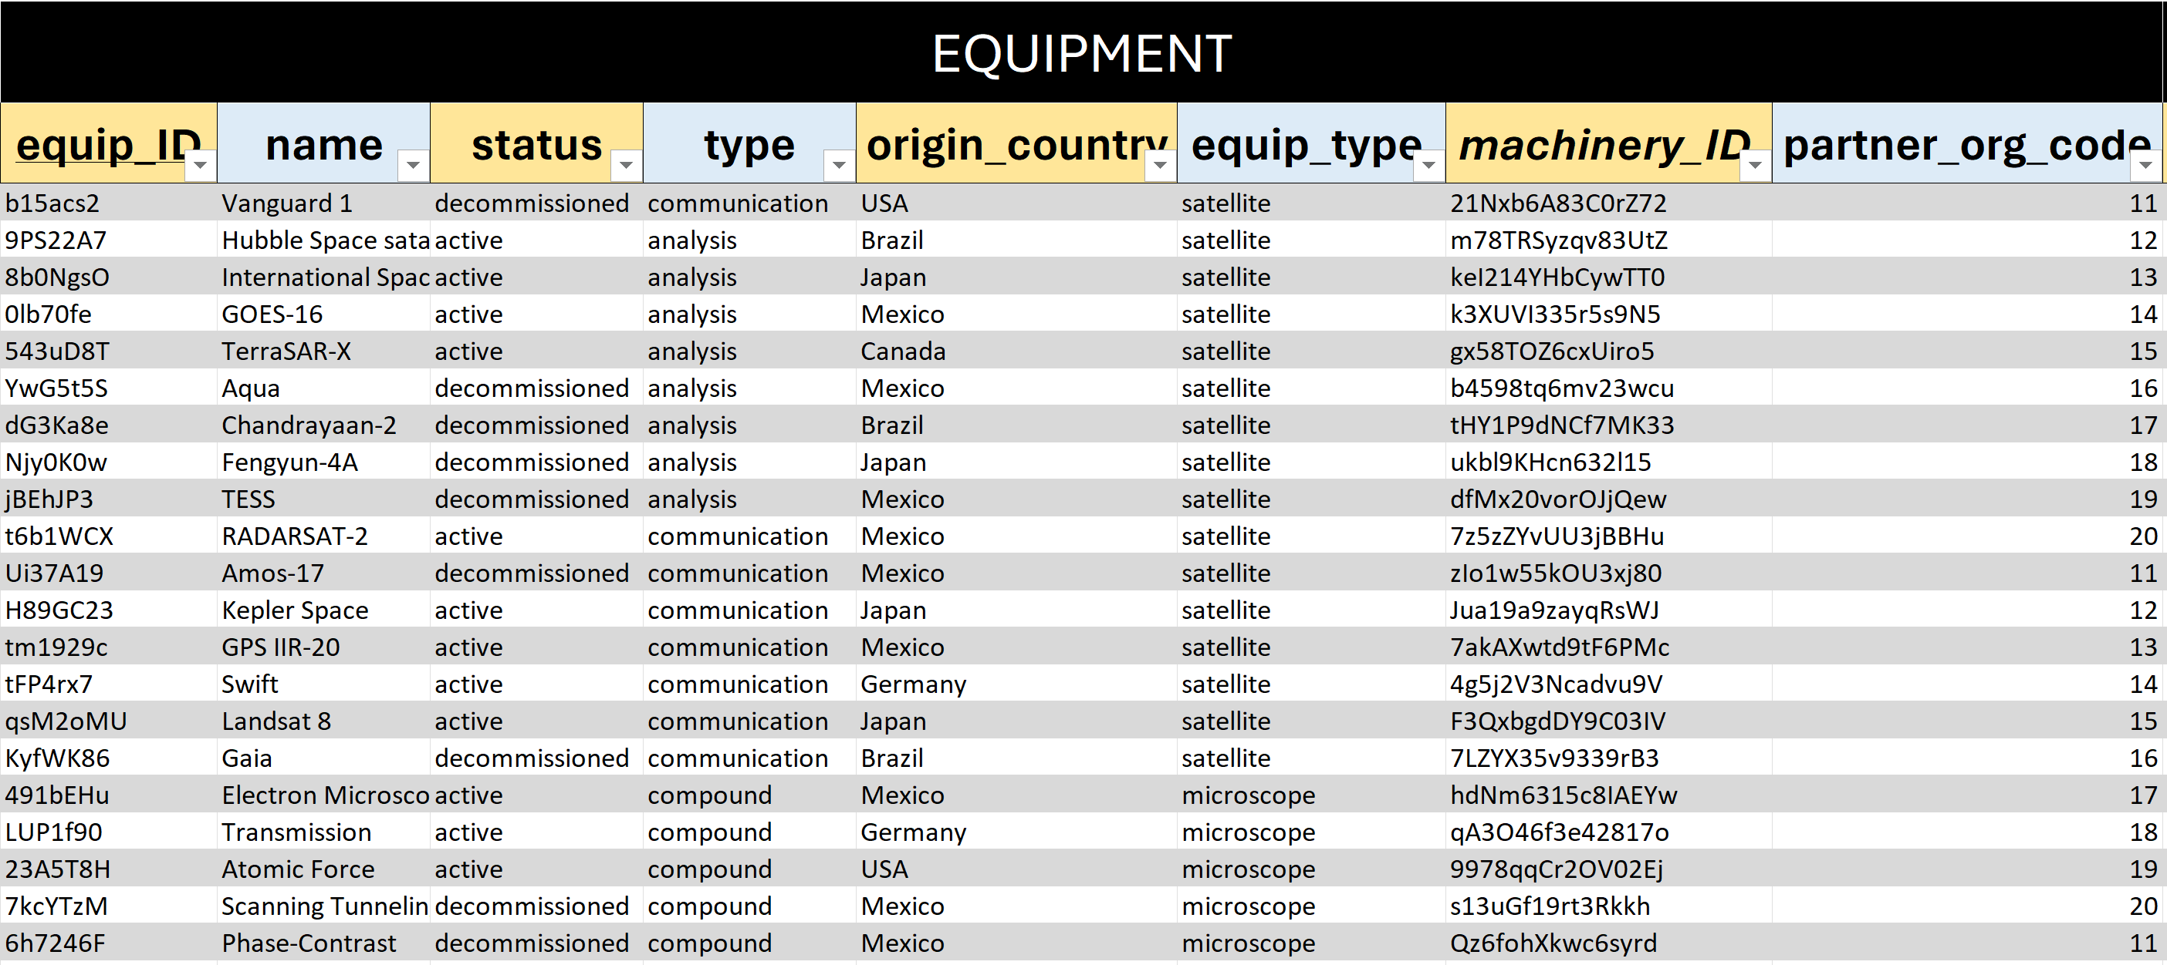

Slide 14

RULES:
1.planet contains at least one material or more and material can exist on several planets.
2.mission can target one planet, but it is not a must, and each planet might be explored with several missions.
3.research is around mission or other objectives and mission must have minimum one research as a result or more.
4.one spacecraft goes to several missions and at least one mission and can be crewed or not with tracking the launch date and end date.
5.the members of staff work in different fields including inspector, astronaut and scientist who can work as an astronaut concurrently.
6.The crew is required to consist of a minimum of 4 astronauts and a maximum of 7 astronauts and every astronaut has to join only one crew.
7. A scientist, whether alone or in collaboration with others, could conduct research using a variety of equipment, although the use of equipments is not a necessity.
8.the agency has several equipment including satellite, telescopes……etc.
9.telescopes must split to two different types:
- space based
- earth based
10.satellites also must split to two different types:
- communication type
- analysis type
11.The communication satellite must be monitored with a group consists of a minimum of 2 inspectors and a maximum of 5 inspectors and every group has to monitor only one satellite of that type.
12.each communication satellite can connect with up to 5 spacecrafts (or none),and every spacecraft must have connection with one satellite.
13.telescope must be launched on spacecraft if it is of space type and spacecraft can launch with one telescope.
14.equipment might be operated with one partner.
15.The partner may supply machines, which are equipment and spacecrafts.
16.some partners participate in research with different fields.

Slide 15
RULES:
1.planet contains at least one material or more and material can exist on several planets.
2.mission can target one planet, but it is not a must, and each planet might be explored with several missions.
3.research is around mission or other objectives and mission must have minimum one research as a result or more.
4.one spacecraft goes to several missions and at least one mission and can be crewed or not with tracking the launch date and end date.
5.the members of staff work in different fields including inspector, astronaut and scientist who can work as an astronaut concurrently.
6.The crew is required to consist of a minimum of 4 astronauts and a maximum of 7 astronauts and every astronaut has to join only one crew.
7. A scientist, whether alone or in collaboration with others, could conduct research using a variety of equipment, although the use of equipments is not a necessity.
8.the agency has several equipment including satellite, telescopes……etc.
9.telescopes must split to two different types:
- space based
- earth based
10.satellites also must split to two different types:
- communication type
- analysis type
11.The communication satellite must be monitored with a group consists of a minimum of 2 inspectors and a maximum of 5 inspectors and every group has to monitor only one satellite of that type.
12.each communication satellite can connect with up to 5 spacecrafts (or none),and every spacecraft must have connection with one satellite.
13.telescope must be launched on spacecraft if it is of space type and spacecraft can launch with one telescope.
14.equipment might be operated with one partner.
15.The partner may supply machines, which are equipment and spacecrafts.
16.some partners participate in research with different fields.

Slide 16
RULES:
1.planet contains at least one material or more and material can exist on several planets.
2.mission can target one planet, but it is not a must, and each planet might be explored with several missions.
3.research is around mission or other objectives and mission must have minimum one research as a result or more.
4.one spacecraft goes to several missions and at least one mission and can be crewed or not with tracking the launch date and end date.
5.the members of staff work in different fields including inspector, astronaut and scientist who can work as an astronaut concurrently.
6.The crew is required to consist of a minimum of 4 astronauts and a maximum of 7 astronauts and every astronaut has to join only one crew.
7. A scientist, whether alone or in collaboration with others, could conduct research using a variety of equipment, although the use of equipments is not a necessity.
8.the agency has several equipment including satellite, telescopes……etc.
9.telescopes must split to two different types:
- space based
- earth based
10.satellites also must split to two different types:
- communication type
- analysis type
11.The communication satellite must be monitored with a group consists of a minimum of 2 inspectors and a maximum of 5 inspectors and every group has to monitor only one satellite of that type.
12.each communication satellite can connect with up to 5 spacecrafts (or none),and every spacecraft must have connection with one satellite.
13.telescope must be launched on spacecraft if it is of space type and spacecraft can launch with one telescope.
14.equipment might be operated with one partner.
15.The partner may supply machines, which are equipment and spacecrafts.
16.some partners participate in research with different fields.

Slide 17
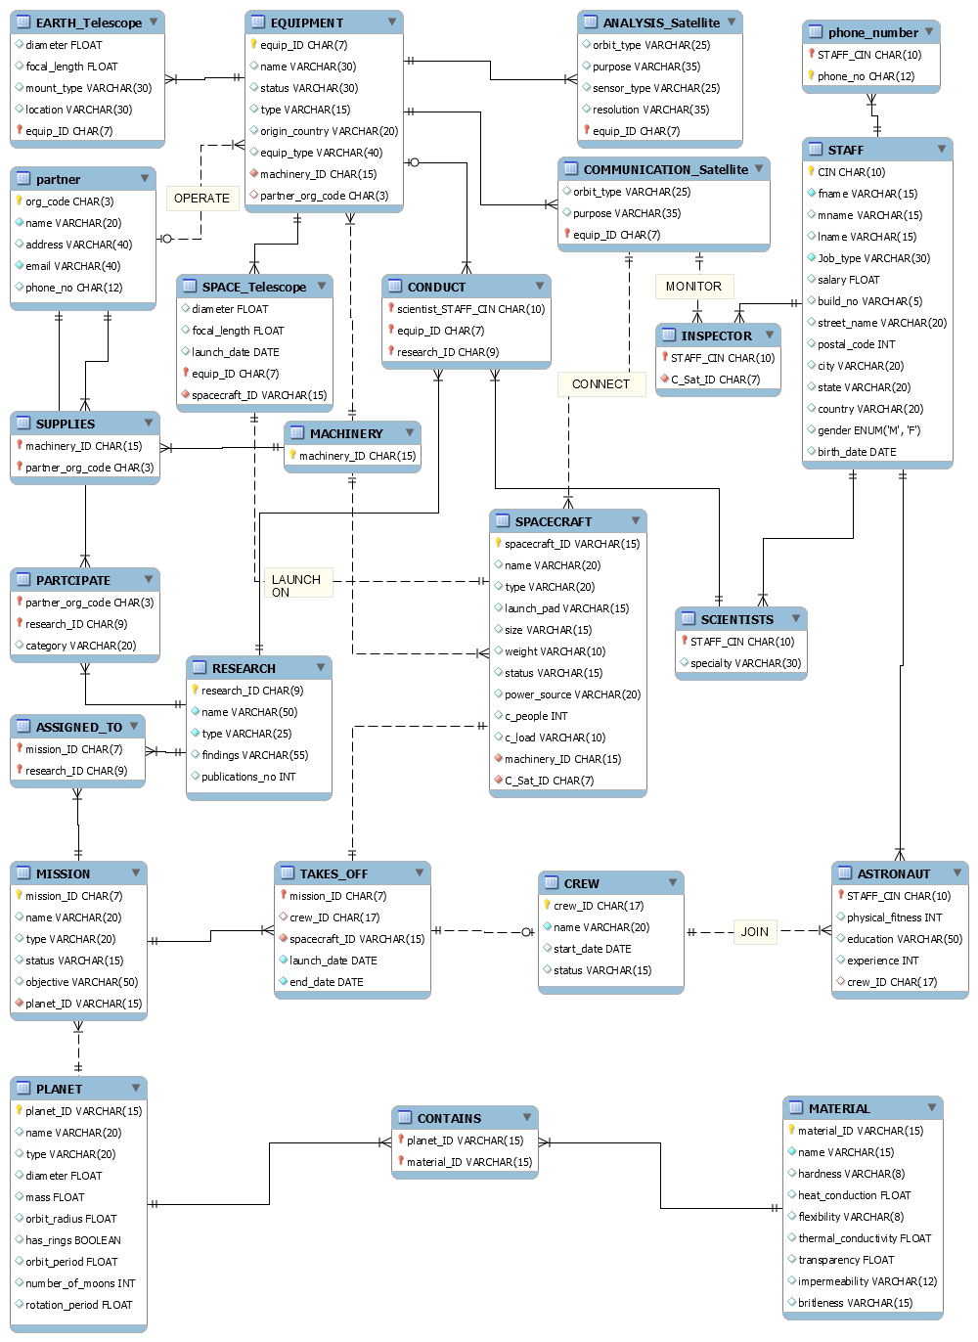

Slide 20
